Slide 1
CS1010S Programming Methodology
Lecture 1
Introduction to CS1010S & Python
14 Jan 2015

Slide 2
Welcome

Slide 3
3 things

Slide 4
WHY should you take CS1010S

Slide 5
WHAT to expect in CS1010S

Slide 6
HOW to learn Python (In 15 mins)

Slide 7
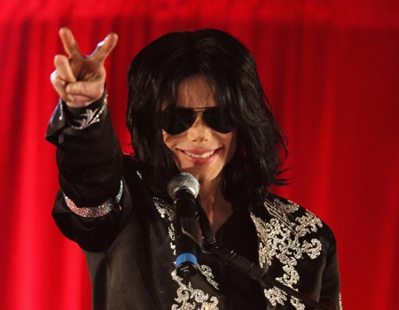
But first… The Cast

Slide 8
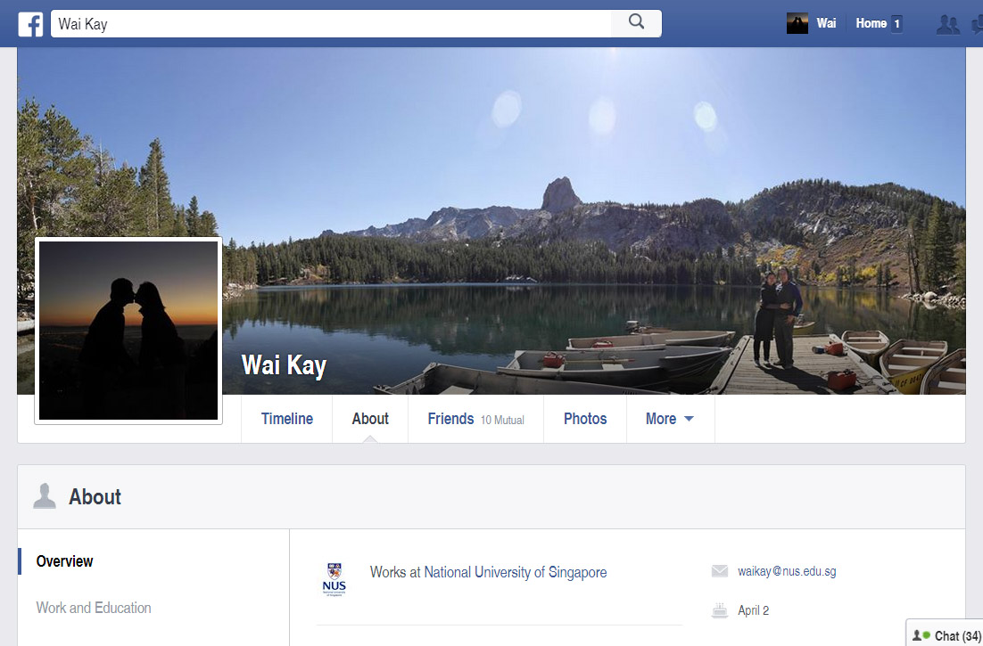

Slide 9
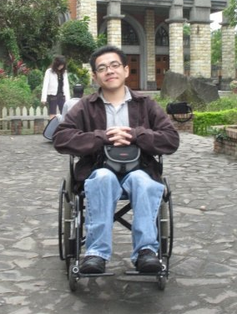
Dr. Chong Ket Fah

Slide 10
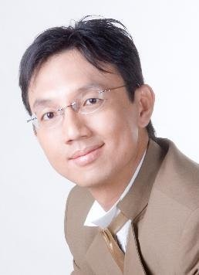
Prof Ben Leong

Slide 11
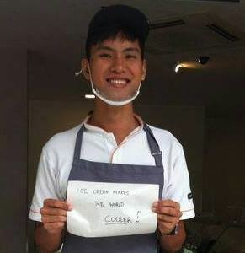
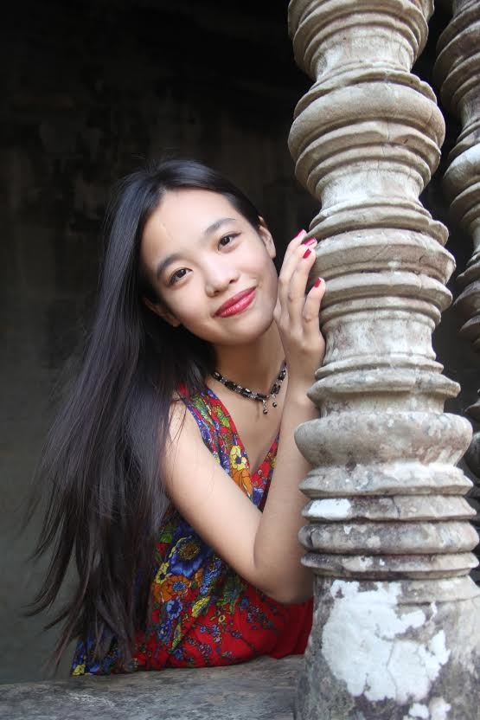
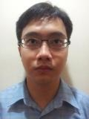
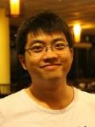
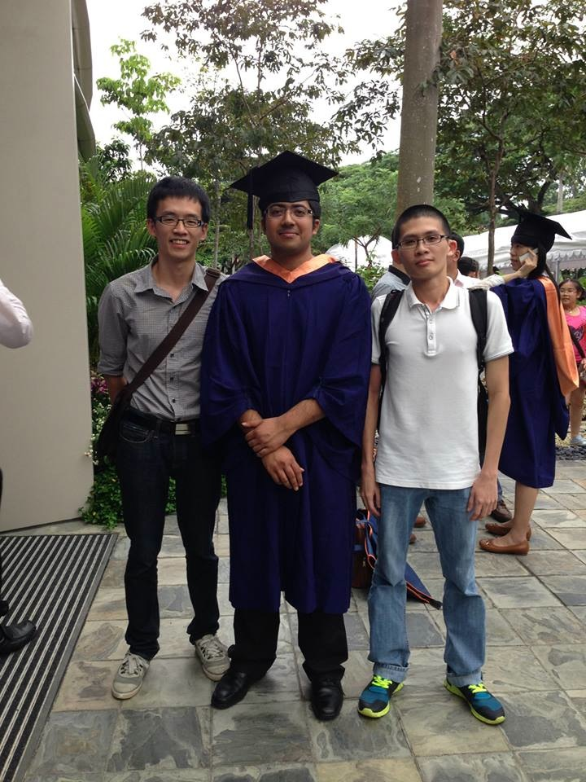
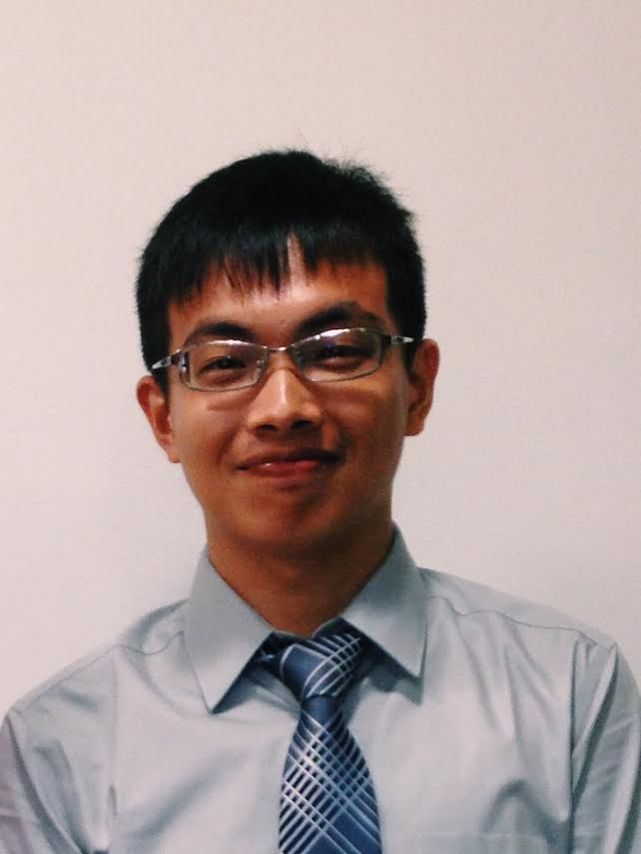
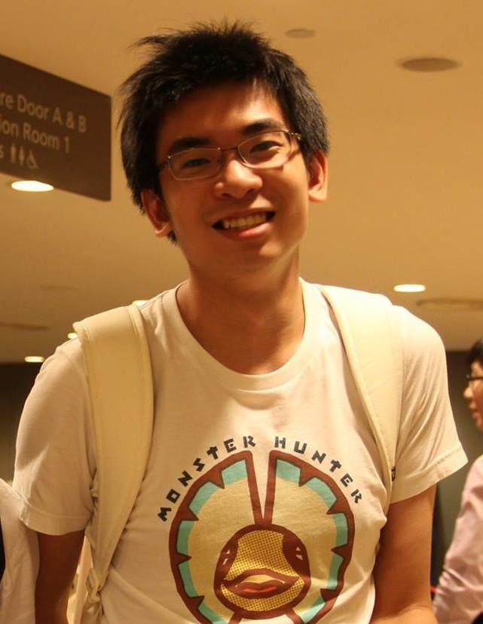
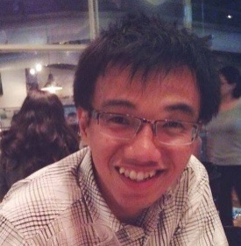
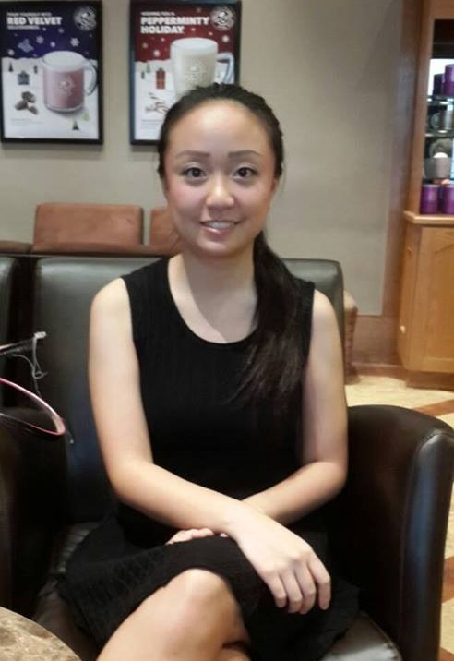
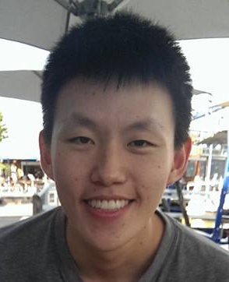
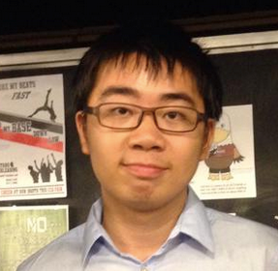
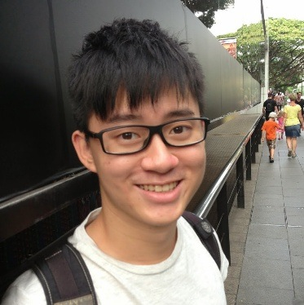
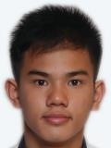
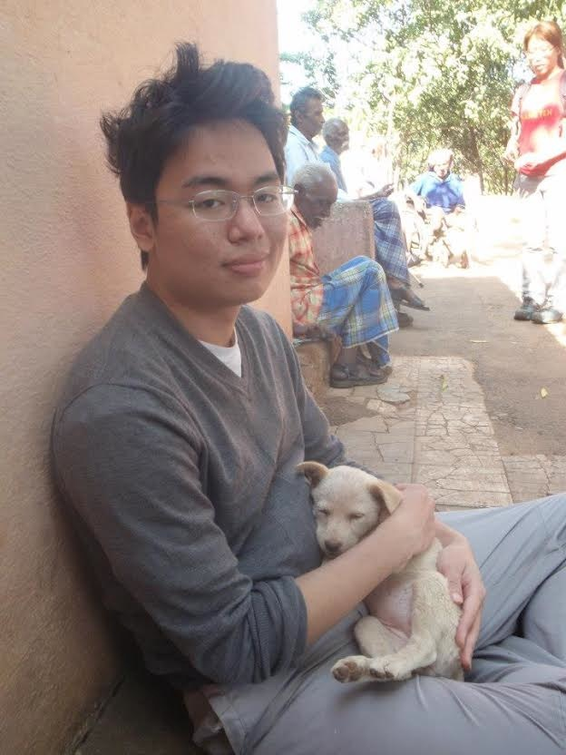
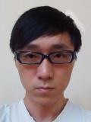
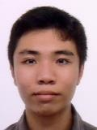
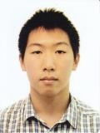
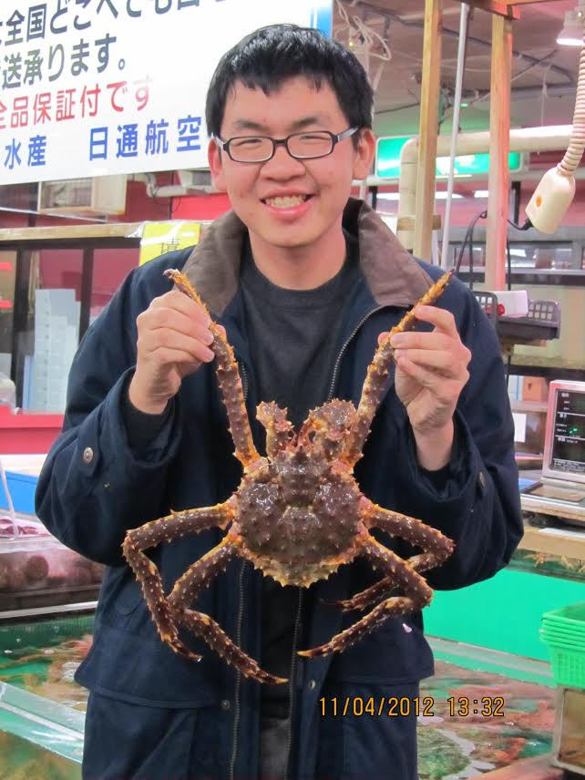
Tutors
Wai Kit
Yan Han
Han Lin
Mingzhou
Minh Tu
Wai Hon
Siyuan
Ryan
Mathias
Jack
Eldric
Yichen
Chun Mun
Jonathan
Leon

Slide 12
WHY should you take CS1010S

Slide 13

WHY are you taking CS1010S

Slide 14
WHY are you taking CS1010S?
Because I love programming.
Because I want to learn programming.
Because I am interested in computing.
Bo bian, core requirement.

Slide 15
WHY you should take CS1010S

Slide 16
1. Because pain is good for you

Slide 17
2. Because computers are useful

Slide 18
2. Because computers are useful
but they are dumb

Slide 19
Computers need precise instructions

Slide 20
Do cool stuff

Slide 21
Help simplify your work

Slide 22
WHAT to expect in CS1010S

Slide 23
Work.

Slide 24
A lot of work.

Slide 25
A lot of hard work.

Slide 26
A lot of hard work. and some fun :)

Slide 27
Lectures Here!

Slide 28
Recitations Start next week

Slide 29
Tutorials Start in week 3

Slide 30
Important Dates
19 & 20 Feb: Chinese New Year
23 Feb: Make-up Recitation
4 Mar: Mid-term Exam
3 Apr: Good Friday
4 Apr: Make-up Recitation
18 Apr: Practical Exam

Slide 31
Scheduling problems

Slide 32
No textbook Save money

Slide 33
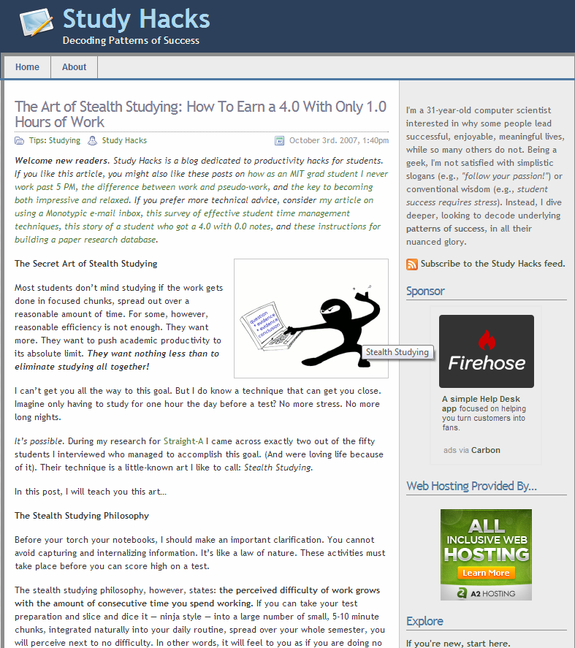

Slide 34
The trick: Consistency

Slide 35
The problem: Staying consistent is HARD

Slide 36
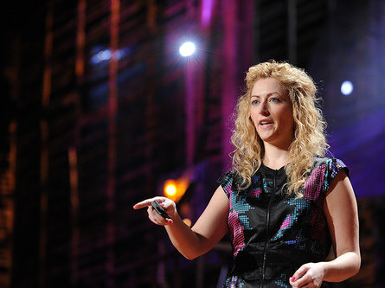
gaming can make a
better world
Jane McGonigal
17 Mar 2010
“

Slide 37
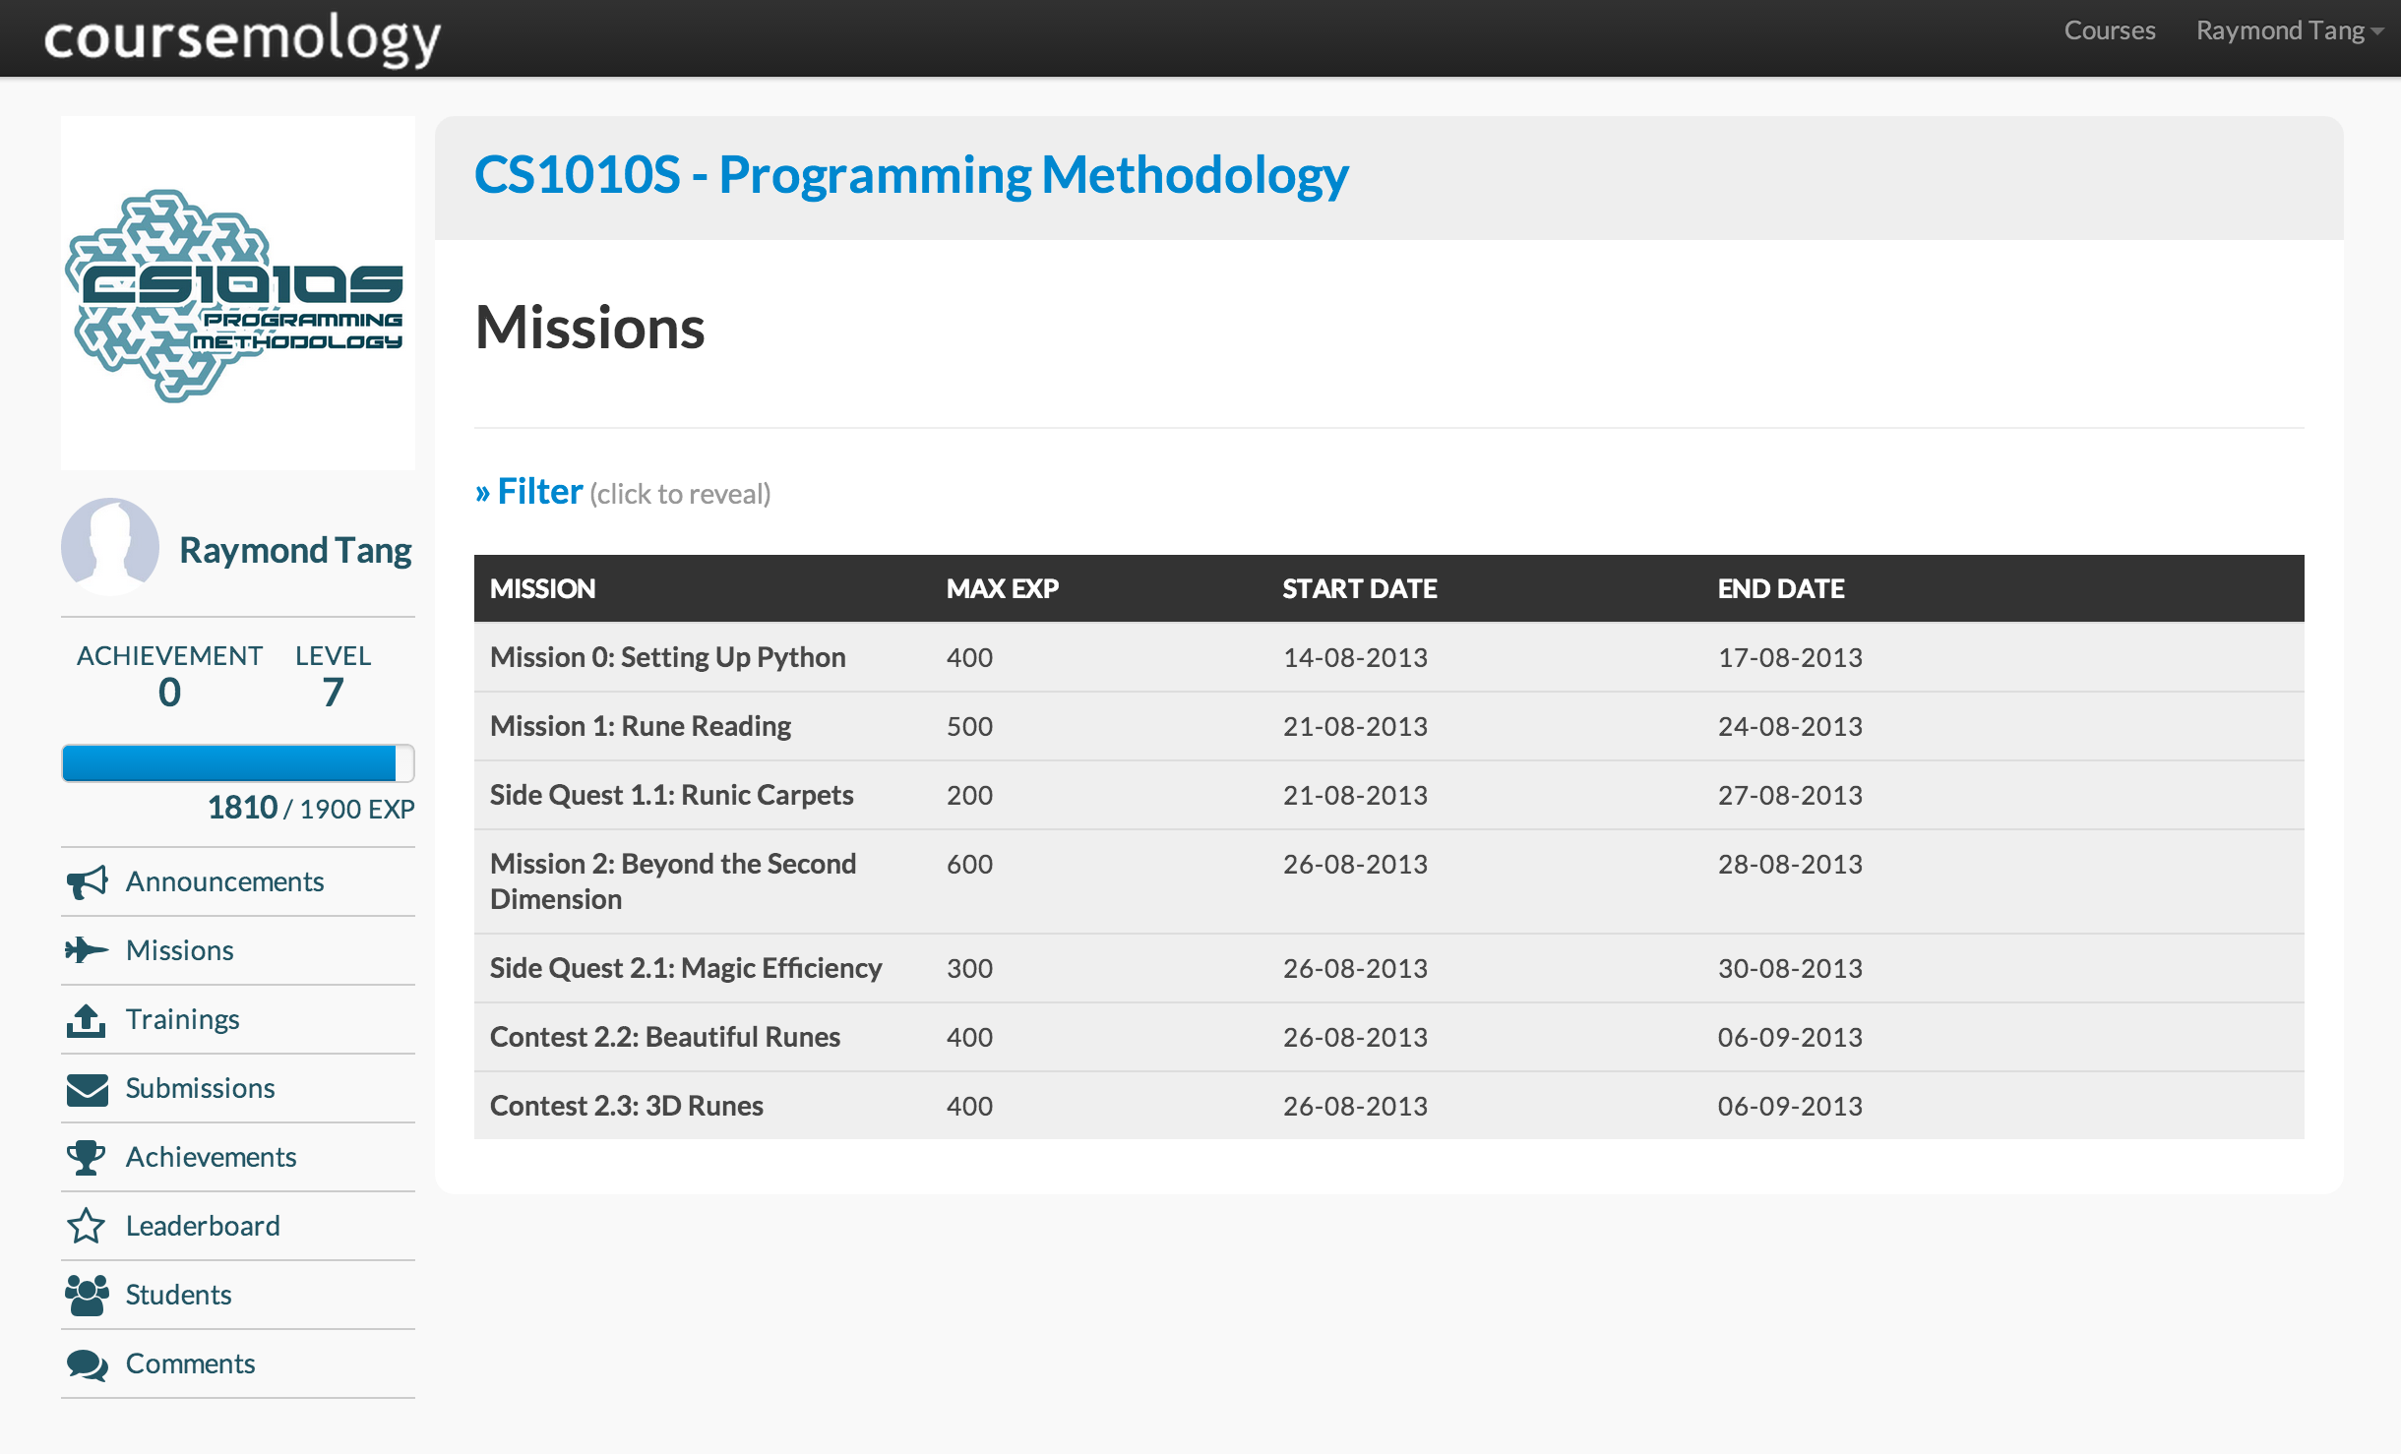

Slide 38
7 Problem Sets
16 Main Missions
+ Side quests & Contests
+ 24-Hour Grading
+ Unlock Achievements
+ Badges
+ Leaderboard

Slide 39
COMPLETE MISSION

Slide 40
COMPLETE MISSION
+XP

Slide 41
COMPLETE MISSION
+XP
COMPLETE SIDEQUESTS

Slide 42
COMPLETE MISSION
+XP
WIN CONTESTS
COMPLETE SIDEQUESTS

Slide 43
COMPLETE MISSION
+XP
WIN CONTESTS
ATTEND TUTORIALS
COMPLETE SIDEQUESTS

Slide 44
COMPLETE MISSION
+XP
WIN CONTESTS
ATTEND TUTORIALS
COMPLETE SIDEQUESTS
POST ON FORUM
(Reflections)

Slide 45
ENOUGH XP?
LEVEL UP!

Slide 46
Lectures
Trainings
Finish by Friday
Exams
Forums
Recitations
Tutorials
+ Trainings
Side-quests
Contests
Missions

Slide 47
Assessment Overview
Coursemology 35%
Tutorial Participation 5%
Mid-term Exam 15%
Wed, 4 March, 12:00 – 14:00
Practical Exam 15%
Sat, 18 April, Morning
Final Exam 30%
Wed, 29 April, 17:00 – 19:00

Slide 48
By all means discuss
But write up the solution yourself

Slide 49
The Theory of Aiming
PASS

Slide 50

The Theory of Aiming
PASS

Slide 51
Not to worry. Help is always available

Slide 52
Remedial TBA

Slide 53
Email Us cs1010s-staff@googlegroups.com

Slide 54
Discussion Forum Do Subscribe

Slide 55
CS1010S Road Map
Memoization
Searching & Sorting
ADVANCED
Dynamic Programming
Object-Oriented Programming
INTERMEDIATE
Higher-Order Procedures
List Processing
Multiple Representations
BASIC
Procedural Abstraction
Data Abstraction
Iteration
Mutation & State
Wishful Thinking
Recursion
Order of Growth
Fundamental concepts of computer programming

Slide 56

Bust some Myths

Slide 57
Myth 1 “I have no programming experience. How can survive?”

Slide 58
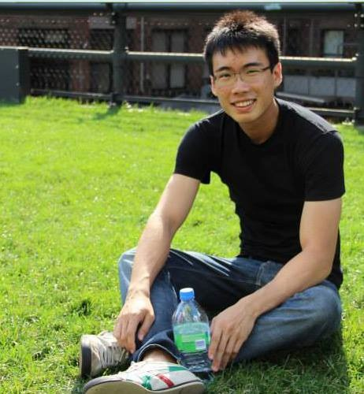
Michael Yong
Year 2
Google Intern
USD7k a month

Slide 59
Myth 2 “I’m a girl, how can you expect me to program?”

Slide 60
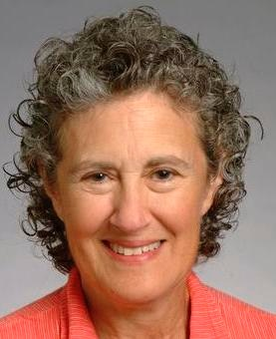
Barbara Liskov
ACM Turing Award 2008

Slide 61
Last Semester 4 of the top 5 students are girls

Slide 62
Myth 3 “The bell-curve will save me.”

Slide 65
Let’s hear it from your seniors

Slide 66
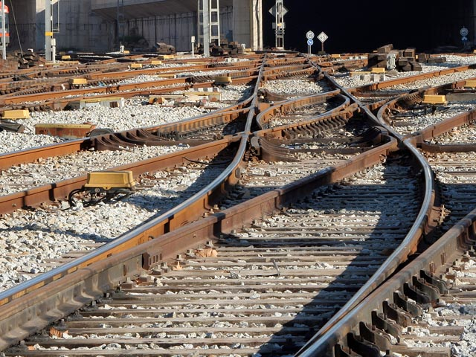
many paths to
success

Slide 67
HOW to learn Python (In 15 mins)

Slide 68

IDLE
Free download: http://www.python.org/download/releases/3.4.2/

Slide 69
Python 2 vs Python 3

Slide 70
Python 3.4.2 for CS1010S

Slide 71
Mission 0
Setting up Python

Slide 72
Python Clinic
Announcement on Coursemology

Slide 73
Why Python
Clear and readable syntax
Intuitive
Natural expression
Powerful
Popular & Relevant

Slide 74
Simplicity

Slide 75
Futile to Teach a Language Here today, gone tomorrow

Slide 76
Computational Thinking

Slide 77
Elements of Programming

Slide 78
1. Primitives

Slide 79
Numbers: 4 , 7/2 , 428.3
Operators: + , - , * , /
Symbols: a , pi , foo

Slide 80
2. Means of Combination

Slide 81
5 + 3
((5 + 3)-(2 * 3))
8
2

Slide 82
3. Means of Abstraction

Slide 83
13
7 + 6
a = 3
a + 6
9

Slide 84
4. Controlling Logic

Slide 85
If the light is red,
stop.
Else if it is amber,
accelerate.
Else,
proceed with caution.

Slide 86


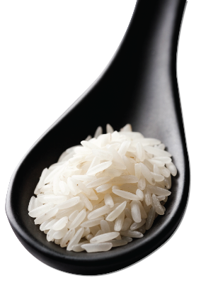
While you are hungry,
eat a spoonful of rice.
Burp.

Slide 87
Variables
Start with ‘a’-‘z’ or ‘A’-‘Z’ or ‘_’
Contain only alphanumeric characters or ‘_’
Case sensitive
Ian_Lee != ian_lee

Slide 88
Variables
Avoid reserved keywords e.g. if
Python convention: lower case letters separated by ‘_’
e.g. count_change
Store memory addresses

Slide 89
Types
int
float
bool
str
None
8, 45, 1234
2.3, 3.14159
True, False
“cs1010s” ‘cs1010s’

Slide 90
Type(…)
>>> type(123)
<class ‘int’>
>>> type(‘123’)
<class ‘str’>
>>> type(None)
<class ‘None’>

Slide 91
Type conversion
>>> str(123)
‘123’
>>> float(‘45.2’)
45.2
>>> int(23.8)
23
>>> int(‘cs1010s’)
ValueError!

Slide 92
Assignment
>>> abc = 18
>>> my_string = ‘This is my string’
>>> x, y = 1, 2
variable | address
abc | id1
my_string | id2
id1: int
18
id2: str
“This is my string”
id3: int
x | id3
y | id4
1
id4: int
2

Slide 93
Operators
+
-
*
/
**
//
%
Arithmetic:
>>> a = 2 * 3
>>> a
6
>>> 2 ** 3
8

Slide 94
Operators
+
-
*
/
**
//
%
Arithmetic:
>>> 11 / 3
3.6666666666666665
>>> 11 // 3
3
>>> 11 % 3
2

Slide 95
Truth Values
Statements can be either true or false
2 > 1 is true
5 < 3 is false

Slide 96
Operators
>
>=
<
<=
==
!=
Comparison:
>>> 1 <= 10
True
>>> 5 > 15
False
>>> 5 <= 5
True

Slide 97
Operators
>
>=
<
<=
==
!=
Comparison:
>>> 2 != 3
True
>>> ‘1’ == 1
False
>>> False == False
True

Slide 98
Operators
or
and
not
Logic:
>>> True or False
True
>>> True and False
False
>>> not False
True

Slide 99
Truth Tables
OR | True | False
True | True | True
False | True | False
AND | True | False
True | True | False
False | False | False
NOT
True | False
False | True

Slide 100
Truth Value Revisted
Python has keywords True and False
In Python 3.x, True and False will be equal to 1 and 0
Anything that is not 0 or empty will be evaluated as True

Slide 101
Operators
or
and
not
Logic:
>>> True and 0
0
>>> not ‘abc’
False
>>> 1 or 0
1

Slide 102
Strings
>>> s = ‘ba’
>>> t = ‘ck’
>>> s + t
‘back’
>>> t = s + ‘na’ * 2
>>> t
‘banana’
>>> ‘z’ in t
False
>>> ‘bananb’ > t
True
>>> ‘banan’ <= t
True
>>> ‘c’ < t
False

Slide 103
String Slicing
A String is a sequence of characters
We can index a string, i.e.
>>> s = ‘abcd’
>>> s[0]
‘a’
>>> s[2]
‘c’
First character is 0

Slide 104
String Slicing
s[start:stop:step]
>>> s = ‘abcdef’
>>> s[0:2]
‘ab’
>>> s[1:2]
‘b’
>>> s[:2]
‘ab’
non-inclusive
>>> s[1:5:3]
‘be’
>>> s[::2]
‘ace’

Slide 105
Conditional
if <expr>:
statement(s)
e.g.
>>> a = 3
>>> if a > 0:
print(‘Good’)
‘Good’
indentation

Slide 106
Conditional
if <expr>:
statement(s)
else:
statement(s)
e.g.
>>> a = 3
>>> if a > 0:
print(‘yes’)
else:
print(‘no’)
‘yes’

Slide 107
Conditional
if <expr>:
statement(s)
elif <expr>:
statements(s)
else:
statement(s)
e.g.
>>> a = -3
>>> if a > 0:
print(‘yes’)
elif a == 0:
print(‘no’)
else:
print(‘huh’)
‘huh’

Slide 108
Conditional
if <expr>:
statement(s)
elif <expr>:
statements(s)
elif <expr>:
statements(s)
else:
statement(s)
e.g.
>>> a = 4
>>> if a > 0:
print(‘yes’)
elif a == 0:
print(‘no’)
elif a == 4:
print(‘ahh’)
else:
print(‘huh’)
‘yes’

Slide 109
Conditional
while <expr>:
statement(s)
>>> a = 0
>>> while a < 5:
a = a + 1
print(a)
1
2
3
4
5

Slide 110
Python in 15 mins

Slide 111
Am I now a programmer?

Slide 112
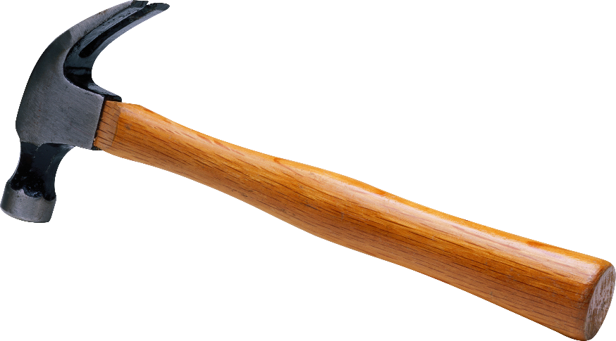
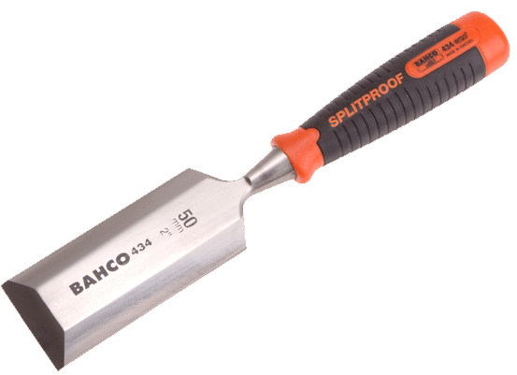
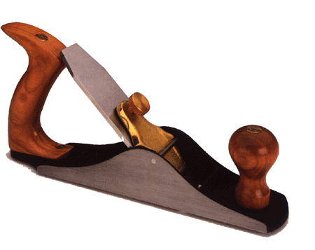
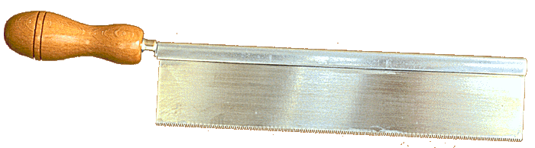
Are you now a carpenter?

Slide 113
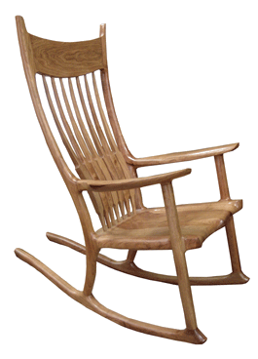
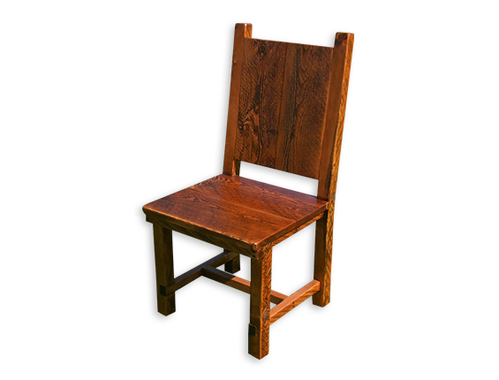
Can you build this chair?

Slide 114
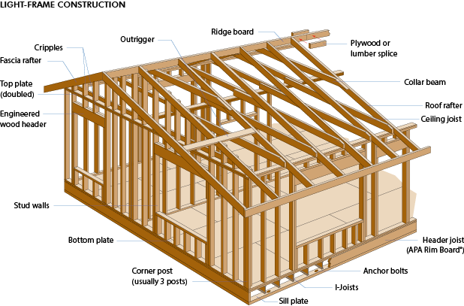

Slide 115
Programming
Not just learning the tools

Slide 116
Programming
Not just learning to read code

Slide 117
Programming
Learn to design code

Slide 118
Practice
Practice
Practice

Slide 119
Learning how to Learn

Slide 120
Questions?

Slide 121
Ways to earn XP
Survey +100 XP
before 24 Jan
Training +100 XP
By Friday
+ 50 XP
otherwise

Slide 122
Ways to earn XP
Link to FB +20 XP
Mission 0 +300 XP
due 18 Jan, 23:59
Forum + ?? XP
within 7 days

Slide 123

See you next week.

